Slide 1
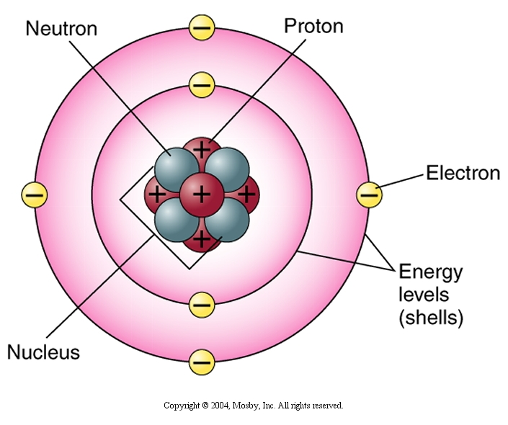
Chemistry of Life
All matter is composed of tiny particles called atoms. There are 109 types of atoms.
A substance made up of one kind of atom is called an element.
An atom is the smallest part of an element that still has the properties of that element.

Slide 2
Atomic Structure
Each atom is made up of smaller parts called protons, electrons and neutrons. Protons and neutrons are found in the central portion of the atom called the nucleus.
Each proton has a positive (+)
electrical charge. The neutrons have no charge (are neutral). The weight or mass of the atom is the sum of the number of protons and neutrons in the nucleus.
Electrons are found in orbits or shells at different distances around the nucleus. The electron has a negative electric charge.

Slide 3
Molecules and Compounds
Atoms frequently bond with each other to form molecules. A molecule can contain atoms of the same kind as when two atoms of oxygen bond with each other to form an oxygen molecule. The chemical formula for the oxygen molecule is O_{2.} Molecules can also form from the combination of two or more different kinds of atoms. This kind of molecules is called a compound. Examples of compound formulas would be CO₂ for carbon dioxide and NaCl for sodium chloride.
In a compound, the different elements seem to lose their individual characteristics. For example, sodium is an explosive, dangerous substance. Chlorine is a highly poisonous gas. When the two are combined chemically they form sodium chloride, a nonpoisonous substance we commonly sprinkle on our food.

Slide 4
Compounds and Chemical Formula
A compound is a substance made up of atoms of two or more elements combined chemically. When they are combined chemically, it is very difficult to separate out the different elements just as it is very difficult once a cake is baked to separate out the eggs, flour, sugar and other ingredients.
Compounds often have common names such as water or salt - but are also named by their formula which tell what elements make up the compound and in what proportion. For example, the smallest bit of water, a molecule of water, is made up of two hydrogen atoms for every one oxygen atom. A formula is similar to a very precise recipe for a compound.

Slide 5
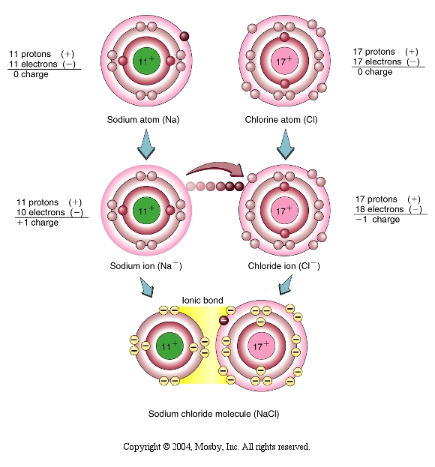
Ionic Bond
There are two types of bonds that can form between atoms. The first is called ionic. An ionic bond forms between two atoms that are not “satisfied”. For example look at the diagram of the sodium and chlorine atoms below. The outer shell around sodium would be satisfied if it could get rid of the one electron. The outer electron shell around chlorine would be “happy” to have one more electron (please note that the atoms start with equal numbers of electrons and protons). The solution: sodium gives an electron to chlorine

Slide 6
Ionic Bond
As a result of sodium giving chlorine an electron, sodium now has one less electron than protons. This gives sodium an electrical charge of 1+. Sodium is now called an ion (a positively charged ion is referred to as a cation). When chlorine gains the electron from sodium, chlorine now has one more electron than protons and becomes a negatively charged ion. Negatively charged ions are called anions.

Slide 7
Molecules and Compounds – Ionic Bond
Due to the opposite electrical charges of the sodium and chloride ions, these particles are attracted to each other. The force of attraction holding these ions together is called an ionic bond. The result of this reaction is the formation of a molecule of sodium chloride.

Slide 8
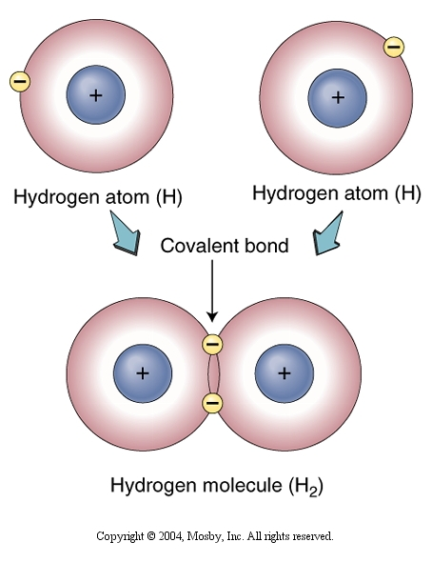
Molecules and Compounds – Covalent Bond
Atoms may also satisfy their outer shells of electrons by sharing pairs of electrons. This can be seen in the example to the right. Here two atoms of hydrogen are brought very close to each other. Each atom needs one electron to satisfy its electron shell. The sharing of electrons between the hydrogen's forms a covalent bond.

Slide 9
Covalent Bond
Covalent bonds are much stronger than ionic bonds. Dissolving sodium chloride (table salt) in water breaks the ionic bonds between sodium and chloride ions. The covalent bond holding the hydrogen molecule together is not broken when hydrogen gas (H₂) is dissolved in water
Covalent bond
Hydrogen molecule (H₂)

Slide 10
Mixture
A mixture is a loose combination of different substances. Unlike a compound, these substances can be physically separated and when they are combined, the amounts of each substance are not fixed.
A mixture would be like a green salad where the different vegetables can be put together in a bowl, but can be easily separated. A compound is more like a baked cake where it would be very difficult to separate out the ingredients once the cake is baked.

Slide 11
Properties of a Mixture and a Compound
The different parts of a mixture keep their own properties when put together. Substances go through a chemical change to form a compound. In a compound, the different elements seem to lose their individual characteristics.
For example, sodium is an explosive, dangerous substance. chlorine is a highly poisonous gas. When the two are combined chemically they form sodium chloride, salt, a nonpoisonous substance we sprinkle on our food.

Slide 12
Solution
One kind of mixture is a solution. A solution is a mixture of two or more substances in which one of these substances (the solute) is dissolved in another substance such as water or another sort of liquid (solvent). A solute can be a gas, solid or liquid. Some common solutions include ammonia and vinegar as well as salt water. The amount of the solute compared to the solvent in a solution is the concentration of the solution. When the solvent contains the most solute it can hold, it is said to be saturated; if it has less solute than it can hold, it is unsaturated.

Slide 13
Suspension
A suspension is a mixture in which the particles that are in the suspension are able to be seen by the naked eye.
After waiting a while, the particles in a suspension will settle to the bottom of the container. For example if a test tube of blood is allowed to stand undisturbed, the blood cells will settle to the bottom of the test tube leaving a clear solution above called the plasma.
The parts of mixtures can be separated from each other by evaporation, precipitation or filtration.
Plasma
Blood
cells

Slide 14
Water
Water is the most abundant molecule in the body. Water forms the internal ocean that baths every cell of the human body. It makes up around 65% of the body weight. The water molecule is composed of one atom of oxygen and two atoms of hydrogen held together by covalent bonds.
The shape of the water molecule and the atoms in it give water a special property called polarity. This means that one end of the molecule is slightly positive while the other end is slightly negative.
-
O
H
H
+

Slide 15
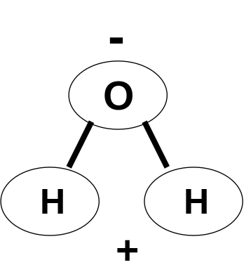
Universal Solvent
The water of the body contains many substances in solution. In a solution one or more substances are dissolved. The dissolved substances are called solutes. The water which dissolves the solutes is called the solvent. Water is so effective at dissolving substances that it is referred to as the universal solvent. In the diagram below it can be seen how the polar water molecules surround and pull apart the ions in a molecule of sodium chloride. Notice how the negative ends of water attract sodium and the positive ends attract chloride.
Na+
Na+
Cl-
Cl-

Slide 16
An Ion
An ion is an atom or group of atoms that have a net electrical charge. An ion is formed when electrons are gained or lost by an atom. A neutral atom has equal numbers of protons and electrons so there is no net electrical charge.
A simple ion is made up of only one charged atom with either a positive or negative charge. A complex ion is one with a number of atoms with a net charge that is positive or negative. If an atom loses electrons, the ion has a positive charge. This kind of ion is called a cation. If an atom or atoms gain electrons, the ion will have a negative charge. This kind of ion is called an anion.
Examples of cations: Sodium ion (Na⁺), Calcium ion (Ca⁺⁺)
Examples of anions: Chloride ion (Cl⁻), Bicarbonate ion (HCO₃⁻)

Slide 17
Electrolytes
Substances that form ions in solutions are called electrolytes. Those that don't form ions in solutions are called non-electrolytes. When electrolytes such as sodium chloride dissolve in water, their ions will conduct electricity through the solution. A substance such as table sugar or sucrose will not form ions in solution and will not conduct electricity.
A demonstration in class will allow you to see if a substance is an electrolyte or not.

Slide 18
Polarity
When water molecules are close, they tend to attract each other because of their polarity. This attraction between water molecules is responsible for most of the properties of water.
Due to the fact that the molecules hold each other, the temperature of water does not rise or fall very easily. Since the blood is 92% water, this attraction also makes water an excellent material to transport nutrients and wastes through the blood.

Slide 19
pH Scale
The pH scale is a shorthand method of describing the concentration of hydrogen ions in any solution. The pH scale uses numbers from 0 to 14. A solution with a pH number below 7 has an excess concentration of hydrogen ions (H+) and is referred to as an acid. If the pH number is greater than 7, the solution has an excess of hydroxide ions ( OH⁻ ) and is called basic or alkaline. A substance, such as water, with equal concentrations of hydrogen and hydroxide ions has a pH of 7 and is said to be neutral. Notice that the normal pH of the blood is 7.4.

Slide 20
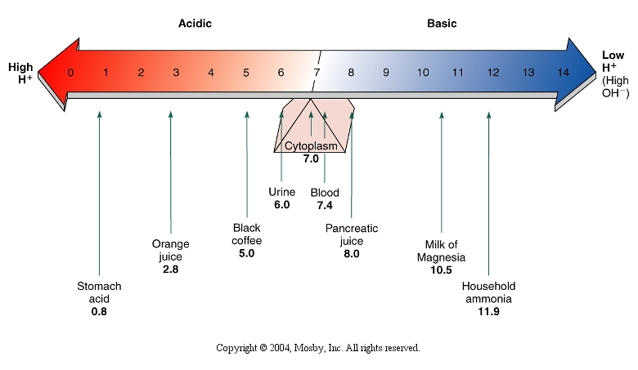
The pH Scale
The diagram below indicates the pH values of some body fluids and household liquids.
neutral
acids
bases

Slide 21
Acids and Bases
Acids in water solutions show certain properties. They taste sour and turn litmus paper red. They react with metals like zinc to give off hydrogen.
Bases in water solutions also show certain properties or characteristics. They taste bitter and turn litmus paper blue. They also have a slimy or slippery texture to them.
Differences in Acids and Bases in Solutions
Acids | Bases
Tastes sour | Tastes bitter
Turns litmus paper red | Turns litmus paper blue
Reacts with some metals to give off hydrogen gas. | Feels slimy or slippery to the touch.

Slide 22
Acids and Bases
Water molecules can breakdown or dissociate into hydrogen and hydroxide ion ions as seen below:
HOH H⁺ + OH ⁻
hydrogen ion hydroxide ion
When a water molecule dissociates equal numbers of these ions are produced. When hydrochloric acid molecules dissociate:
HCl H⁺ ⁺ Cl –
chloride ion
This produces an excess of hydrogen ions. A substance that forms an excess of hydrogen ions is called an acid. A substance that forms an excess of hydroxide ions when it dissociates, such as NaOH, is called a base or alkaline substance.

Slide 23
Organic Chemistry
Organic chemistry is the study of compounds containing carbon. All organic molecules contain carbon. In order to understand life processes, it is necessary to have an understanding of organic chemistry. This is because living organisms are made up of organic molecules and use organic molecules to function.
The chief reason why carbon is so important to organic chemistry and life is due to its ability to form chemical bonds with four other atoms, including other carbon atoms. This allows carbon to form a great variety of organic compounds. There are four basic groups of organic compounds in the body: Carbohydrates, Lipids (fats), Proteins and Nucleic acids.

Slide 24
Organic Substances of the Body
Organic Compound | Elements | Building Blocks
Carbohydrates | Carbon, Hydrogen and Oxygen | Simple sugars (monosaccharides)
Lipids | Carbon, Hydrogen and Oxygen | Glycerol and Fatty Acids
Proteins | Carbon, Hydrogen, Oxygen, Nitrogen, Phosphorus and Sulfur | Amino Acids
Nucleic Acids (DNA and RNA) | Carbon, Hydrogen, Oxygen, Nitrogen and Phosphorus | Nucleotides

Slide 25



Carbohydrates – The Monosaccharides
A carbohydrate is a compound containing the elements carbon, hydrogen and oxygen in which the ratio of hydrogen to oxygen is the same as in water – two hydrogen's to one oxygen. The basic building blocks of carbohydrate molecules are the monosaccharides –glucose, fructose and galactose.
glucose
fructose
galactose

Slide 26
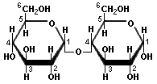
Carbohydrates – The Disaccharides
Two monosaccharides can form a covalent bond between them to form a disaccharide sugar. There are three kinds of disaccharides. Sucrose is a compound containing a glucose joined to a fructose. Sucrose is commonly called table sugar.
Maltose is a disaccharide containing two glucose molecules held together by a covalent bond. Lactose is a sugar found in milk formed by the combination of glucose and galactose.
Molecule of Maltose sugar

Slide 27
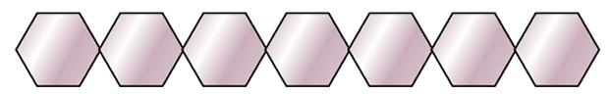
Carbohydrates – The Polysaccharides
When many monosaccharide molecules are joined together with covalent bonds, we have a polysaccharide. Glycogen is a polysaccharide containing many hundreds of monosaccharide subunits. Glycogen is a food stored in the body for energy.
An important structural polysaccharide is cellulose. Cellulose is in wood and the cell walls of plants. You know that shirt you're wearing? If it is cotton, that's cellulose, too! Even though cellulose is formed from sugar, we cannot digest it. Do you know of an animal that can digest plant cellulose?
Polysaccharides are also found in the shells of such crustaceans as crabs and lobsters as a material called chitin.
Polysaccharide

Slide 28
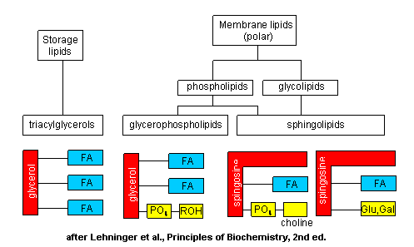
Organic Chemistry - Lipids
Lipids or fats are organic compounds containing carbon, hydrogen and oxygen. Lipids are essential structural components of all cells especially the cell membranes. Lipids also represent an important energy reserve molecule. Gram for gram, lipids provide twice as much energy as carbohydrates. Three important lipids in the body are: triglycerides, phospholipids and cholesterol.
Fatty acid
Fatty acid
Fatty acid
Fatty acid
Cholesterol
Fatty acid
Phosphate
Triglyceride
Phospholipid

Slide 29
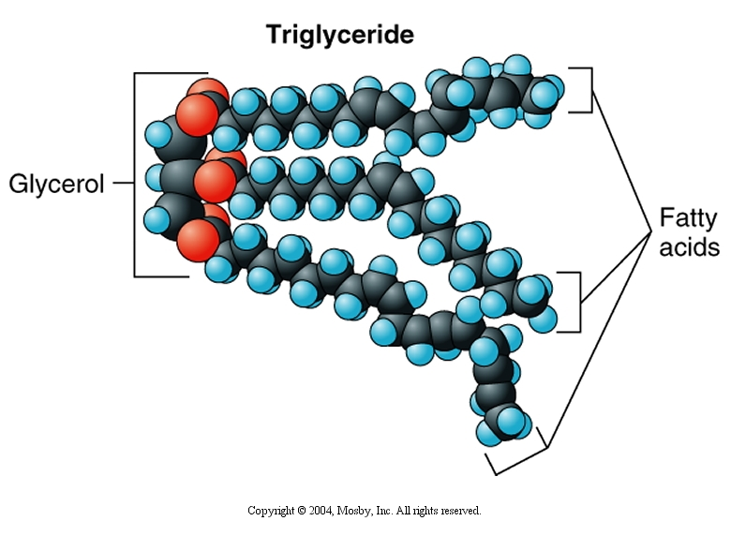
Triglycerides
Triglycerides are lipid molecules formed from two building blocks, glycerol and three fatty acids. Triglycerides store a great deal of energy for the body. When the covalent bonds between the atoms in a triglyceride molecule are broken down, energy is released for life activities.

Slide 30
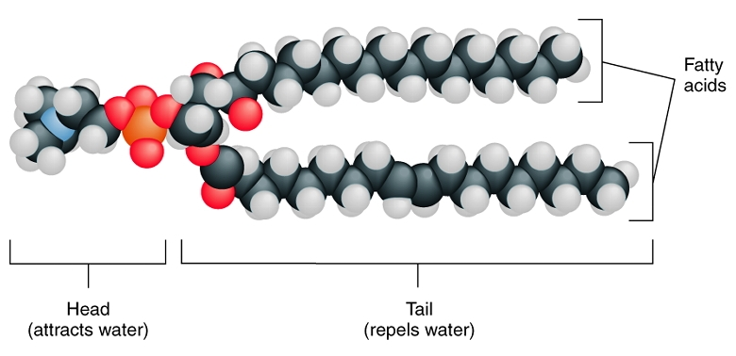
Phospholipids
The phospholipid molecule is similar to a triglyceride except that the third fatty acid is replaced by a phosphate group. Phosphate consists of one phosphorus and four oxygen atoms. The phosphate end of the molecule will dissolve in water and is said to be hydrophilic (“likes water”). The fatty acid end of the molecule repels water and is called hydrophobic (“fears water”).
phosphate

Slide 31
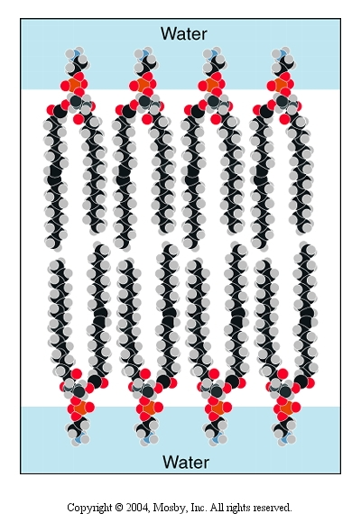
Phospholipid bilayer
When phospholipid molecules are mixed in water, they will form a stable bilayer structure with the phosphate heads facing the water and the water “fearing” fatty acid tails facing each other. This phospholipid bilayer arrangement is the basic structure of the cell membrane.
Hydrophobic tails
Hydrophilic heads

Slide 32
Cholesterol
3
4
1
2
Cholesterol molecule
Cholesterol is an unusual type of lipid. It is made up of four rings (1, 2, 3, 4) of carbon atoms joined together by covalent bonds. Cholesterol is needed for the structure of the plasma membranes of cells. It is also used to manufacture a class of hormones called the steroids. Many baseball and football players have been accused of using steroids to illegally increase their strength.
Some people have a problem with too much cholesterol in their blood. High cholesterol and triglycerides in the blood are a major cause of heart disease

Slide 33
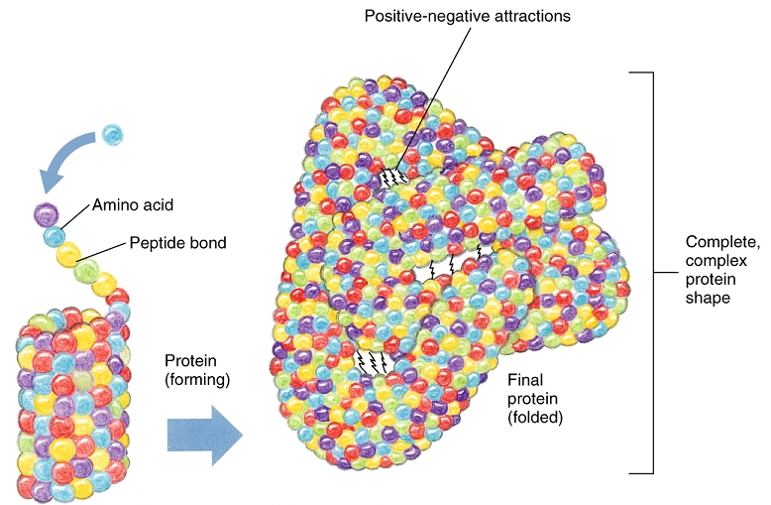

Organic Chemistry – The Proteins
Proteins are very large, complex molecules composed of the elements carbon, hydrogen, oxygen and nitrogen. Other elements are found in proteins in very small amounts. Protein molecules are constructed from building blocks called amino acids. There are twenty different kinds of amino acids. As amino acids are joined to each other with special covalent peptide bonds, the protein molecule grows larger and its shape becomes more and more complex. An example of a very complex protein would be hemoglobin found in the red blood cells.
Typical amino acid

Slide 34
The Proteins - Functions
Proteins carry out a wide range of functions in the body:
Collagen and keratin are structural proteins. Collagen holds the tissues together throughout the body and strengthens ligaments and tendons.
Keratin is a protein that toughens and waterproofs the skin.
Many hormones that regulate body functions are proteins.
The proteins actin and myosin permit our muscles to contract.
Hemoglobin is a blood protein that transports oxygen and carbon dioxide throughout the body.
Antibodies are proteins in the blood and body fluids that help to fight infections.
Enzymes are a special class of proteins that assist other chemicals to react with each other. These reactions are the basis of all life chemistry.

Slide 35
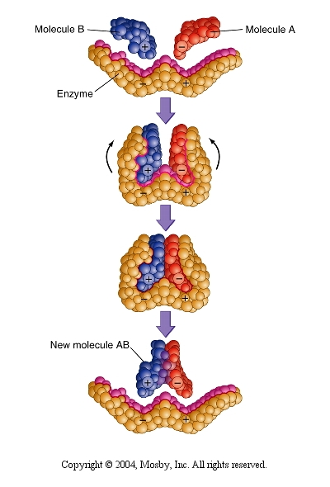
Enzymes
Enzymes are referred to as catalysts. A catalyst is a substance that assists other chemical reactions to occur without being chemically changed itself.
In the example to the right, molecule A and molecule B are joined together to form a new substance AB. Enzymes are needed to permit every chemical reaction in the body to occur.
The most important characteristic of an enzyme molecule is its shape. The shape of the enzyme molecule must fit the shape of the specific molecules the enzyme works on like a key fits into a lock.

Slide 36
Basic Enzyme Reaction
A basic enzyme reaction must have the following components:
The substrate – the material that the enzyme will act upon.
The enzyme – the catalyst that allows the reaction to occur.
The products – the substances produced through the reaction of the enzyme with the substrate.
An example of the action of a typical enzyme would be the reaction produced when the enzyme catalase is exposed to hydrogen peroxide.
Catalase
Hydrogen peroxide Water + Oxygen
Catalase is found in all animal tissues. This reaction is commonly seen when peroxide is applied to an open wound. The release of oxygen in the wound kills dangerous germs.

Slide 37
Enzyme Characteristics
1. Enzymes are used to regulate the rate (speed) of chemical reactions.
2. All enzymes are proteins, but not all proteins are enzymes.
3. Each chemical reaction in an organism requires its own specific enzyme.
4. Each chemical that is worked on by an enzyme is called a substrate.
5. Each enzyme can also be called an organic calalyst.
6. Enzymes are never changed by their reactions! They are reusable

Slide 38
Basis of Enzyme Action
Each enzyme has a specific area for linking up with its own specific substrate. This is called an active site (the place where substrate and enzyme are attached)
THE LOCK AND KEY MODEL
1.) An enzyme and substrate that are compatible link up at the active site. The shapes of the enzyme and substrate fit together like a lock and key
2.) This forms the enzyme-substrate complex where the enzyme goes to work (can put together or take apart a substrate.)
3.) The enzyme and products separate: the enzyme is ready to work on another substrate.

Slide 39
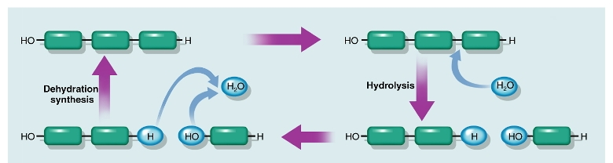
Examples of Enzyme Activities – Dehydration Synthesis and Hydrolysis
Two very common chemical reactions assisted by enzymes are dehydration synthesis and hydrolysis. When the subunits of carbohydrates, lipids and proteins are being put together to form larger molecules, water is removed by the action of an enzyme. This process is called dehydration synthesis. When large organic compounds are being broken down into their subunits, an enzyme controlled reaction adds water between the subunits. This is called hydrolysis.

Slide 40
The Nucleic Acids – DNA and RNA
Deoxyribonucleic acid (DNA) is a very complex double stranded molecule which stores all of the information needed by the cell and the entire organism to carry out life activities. DNA is found primarily in the nucleus of the cell.
Ribonucleic acid (RNA) is a single stranded molecule which is found in several locations within the cell. RNA carries a copy of the coded information in DNA to the place in the cell where that information will be used to manufacture enzymes needed to allow all of the chemical processes of life to occur in the cell.

Slide 41
Deoxyribonucleic Acid - DNA
DNA is a very large molecule (macromolecule) which stores hereditary information that controls the activities of every cell of the body. DNA is built up from building blocks called nucleotides. A nucleotide is made up of three kinds of particles: a sugar molecule, a nitrogen base and a phosphate.
deoxyribose sugar
A DNA Nucleotide
nitrogen base
phosphate

Slide 42
Ribonucleic Acid - RNA
RNA can be thought of as one half of a DNA molecule which carries coded hereditary information from the nucleus of the cell to the cytoplasm. RNA is built up from building blocks called nucleotides. A nucleotide of RNA is made up of three kinds of particles: a ribose sugar molecule, a nitrogen base and a phosphate.
ribose sugar
An RNA Nucleotide
nitrogen base
phosphate

Slide 43
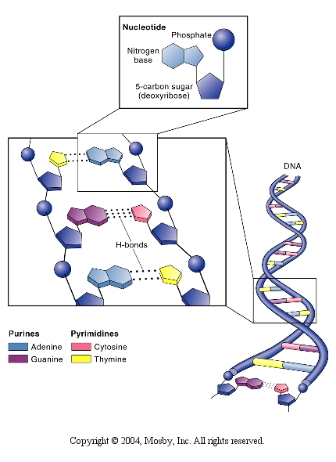
Structure of DNA
There are four kinds of nitrogen bases in DNA: adenine, guanine, cytosine and thymine. The nucleotides containing these bases are put together to form a structure called a double helix. A double helix has the shape of a ladder that has been twisted lengthwise so that the sides of the ladder coil around each other. The sides of the ladder are formed by sugar and phosphate groups. The rungs of the ladder consist of nitrogen bases.

